Slide 1
Sustainability and Business Models
Workshop for the JISC Content Programme
Nancy Maron
Rebecca Griffiths
November 9, 2012

Slide 2
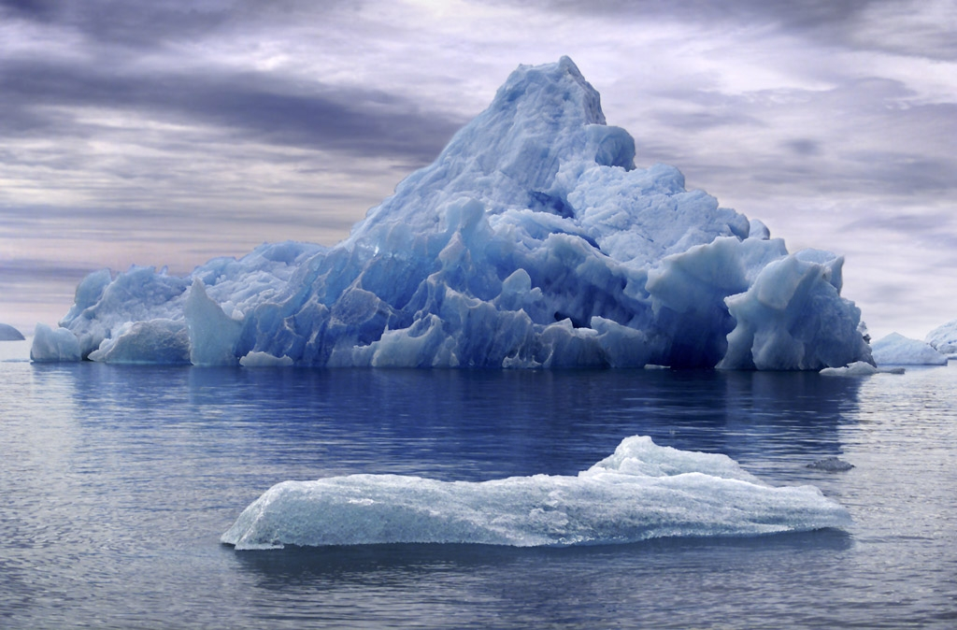
Ithaka S+R: Strategy and Research
:
Research
Consulting
Training
Sustainability and Revenue Models (2008)
Sustaining Digital Resources + case studies (2009)
Funding for Sustainability (2011)
Revenue, Recession, Reliance + case study
updates (2011)

Slide 3
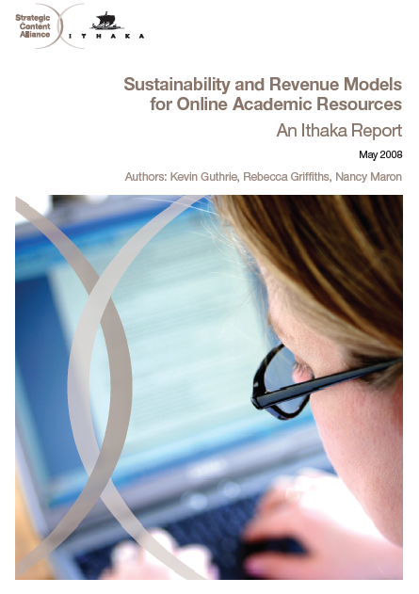
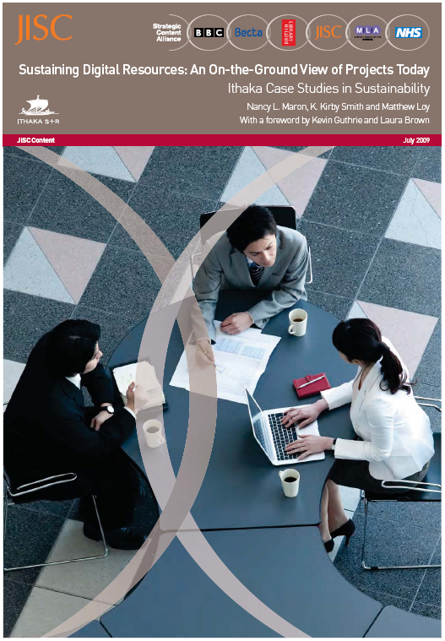
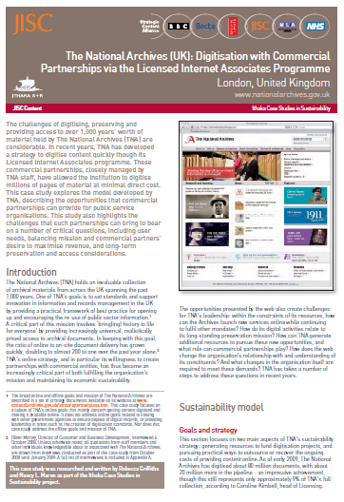
Our work addresses…
Mindsets
Business Models
Strategies
Practices
http://www.sr.ithaka.org/expertise/sustainability

Slide 4
Our plan for today
Objectives
Defining sustainability
What do you want or need to sustain
Developing resources to serve users (audience/market)
BREAK
Revenue models and conditions for success
Where to start : Prioritizing choices
Next steps: Your action plan

Slide 5
Objectives

Slide 6
Is your goal…
To complete this project and move on to other things?
To keep building indefinitely?
To exit gracefully, with the help of a partner?

Slide 7
But first, tell us a little about yourself
Who are you?
Where do you hail from?
What is your project’s principal aim?
How would you describe your
post-grant plan?
DEPOSIT?
BUILD?
?
Notes:
So, DEPOSIT, BUILD, or EXIT?

Slide 8
Defining Sustainability

Slide 9
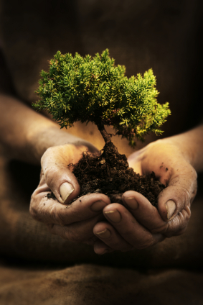
Sustainability is…
For those digital resources that will require ongoing support, ‘sustainability’ is the ability to generate or gain access to the resources—financial or otherwise—needed to protect and increase the value of the content or service for those who use it.

Slide 10
Financial support may be part of the issue…

Slide 11
But a full sustainability plan includes strategy for obtaining all needed sources of support:
Financial Resources
Non-Financial Resources

Slide 12
What are the sources of support you will need to have coming in over time?
Money?
Institutional in-kind support?
Support from audience or other users?
Volunteer activity?
Something else?

Slide 13
To develop your sustainability plan, you will consider…
EXTERNAL FACTORS
Value Proposition
Audience
(users, stakeholders)
Environment
(competition, etc.)
GOALS
INTERNAL FACTORS
ACTIVITIES
COSTS /RESOURCES
FUNDING SOURCES

Slide 14
What do want (need?) to sustain?

Slide 15
For ARL Digitized Special Collections, spending falls sharply post-launch.
Median expenditures
From the Survey of ARL Libraries, Sustainability of Digitized Special Collections. Final report forthcoming, 2012.

Slide 16
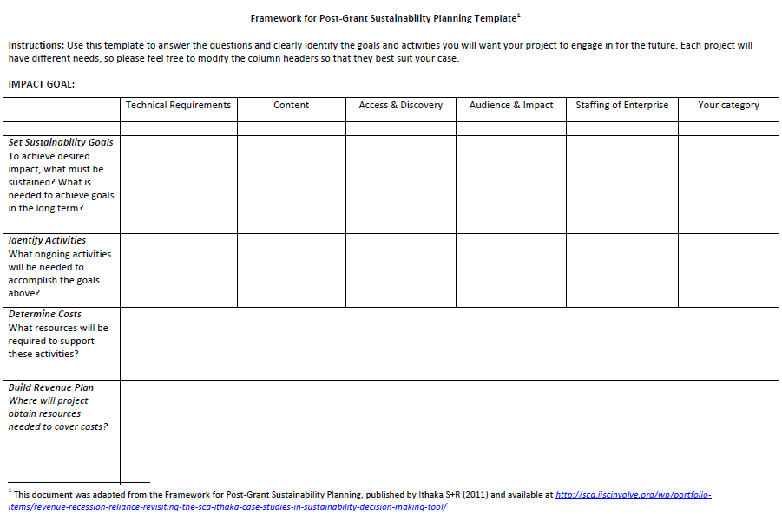
Framework for post-grant sustainability training
Notes:
GROUP WORK, as time allows: Fill in the top row only – thinking about
What DO I really think I need to deliver in these areas to keep my project valuable in future? This will look very different for those who have decided their project requires safe deposit somewhere; and those who fully intend to build their work into something ongoing…
What AREAS of work will be most important for my project?
What specific targets can I set?

Slide 17
What must you pay for… and what can others help with?

Slide 18
Developing resources to serve your audience(s)

Slide 19
Audience = impact = sustainability
What audience(s) will use my resource or service? What does it help them do better / more easily / that they could not before?
How do they know it is available? Why will they come here rather than use other available resources?
Who cares about these benefits and has resources available to support the resource?
How will we communicate this value?

Slide 20
CASE STUDY: A Cautionary Tale
A peer-reviewed collection of learning resources, intended to be used for teaching by secondary and HE instructors
What the project team assumed about the audience
What the target audience actually thought
A hypothetical case:
When self-perception does not match market expectations

Slide 21
Ways to learn about audience
Interviews
Focus groups
Surveys
Usage data
Including users in design
What have you found are pros and cons of various methods?

Slide 22
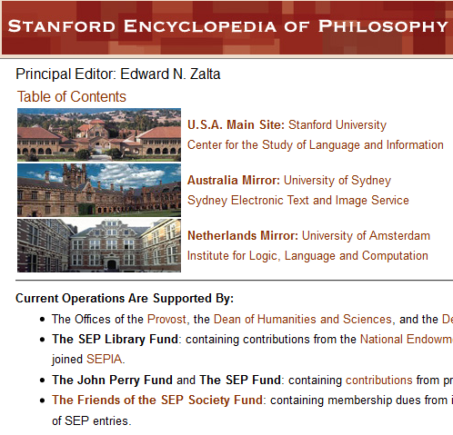
CASE STUDY: Stanford Encyclopedia of Philosophy
An open access resource with an endowment funded by academic libraries
Began with very high-level content, pitched at senior scholars only…
Until audience assessment showed just how many other readers were using it, too.

Slide 23
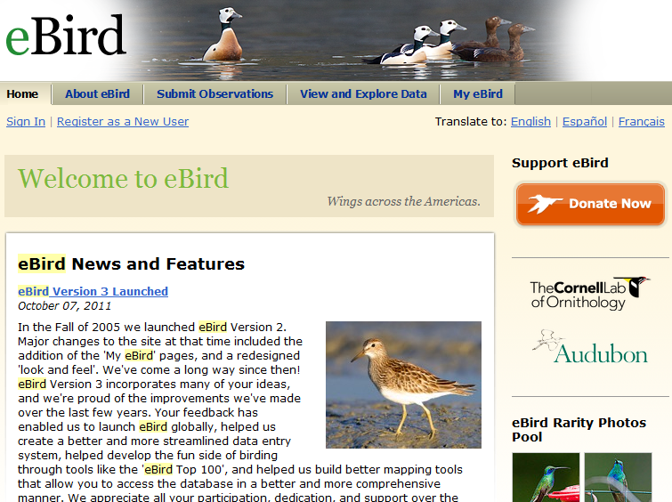
CASE STUDY: eBird
Crowd-sourced database of birding observations
Initial version of the project was aimed at creating valuable data for ornithologists
Became successful only after learning more about what amateur birders really found useful…

Slide 24
Describe a single audience segment vital to your sustainability
What do you know, or think you know, about:
The size of this segment
Why do they currently use your site?
(or why might they someday use it?)
How else might they achieve their goals?
What makes your resource their best option?
How do they learn about you?
What makes them come back?
What data are these assumptions based on? How could you test these beliefs?
What changes have you made as a result of this research?

Slide 25
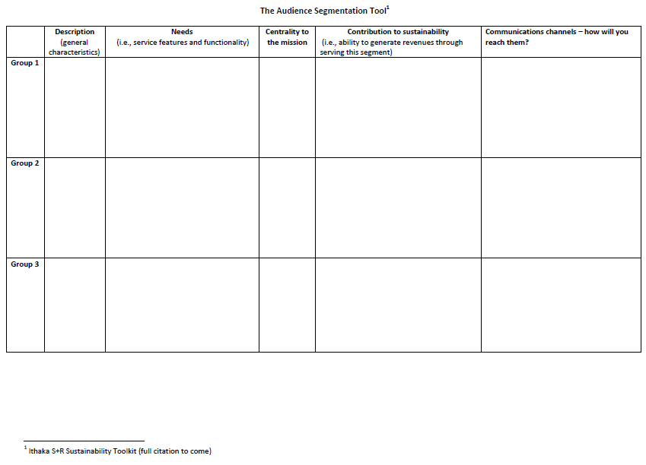
Audience Segmentation Tool

Slide 26
Revenue models and conditions for success

Slide 27
What is your revenue objective?
I need to cover costs of a certain activity
I need to cover all my costs going forward

Slide 28
What are obstacles to trying revenue generation?

Slide 29
Almost half of the ARL institutions who responded had tried some sort of revenue generation.
Has your institution ever tried to generate revenue from
your digitized special collections?
Why haven’t the rest?
This slide is DRAFT only. For the final data slides, please see the Survey of ARL Libraries, Sustainability of Digitized Special Collections. Final report forthcoming, 2012.

Slide 30
Many felt revenue generation was inconsistent with mission aims.
Please briefly describe why your institution has never tried to generate revenue from your digitized special collections.
This slide is DRAFT only. For the final data slides, please see the Survey of ARL Libraries, Sustainability of Digitized Special Collections. Final report forthcoming, 2012.

Slide 31
But some were experimenting with a range of models
Which methods of revenue generation have you tried?
Other: charging other units within the university, licensing to third-party product developers, digitizing/selling products through university press, selling prints, custom/sponsored digitization
This slide is DRAFT only. For the final data slides, please see the Survey of ARL Libraries, Sustainability of Digitized Special Collections. Final report forthcoming, 2012.
Notes:
Question only given to those who had tried to generate revenue from digitized special collections.

Slide 32
While most institutions that generate revenue brought in under $10,000 last year, a few earned more.
Approximately how much revenue did your institution generate from your digitized special collections last year?
Outliers
$325,000
$530,000
This slide is DRAFT only. For the final data slides, please see the Survey of ARL Libraries, Sustainability of Digitized Special Collections. Final report forthcoming, 2012.

Slide 33
What model might be the best fit?

Slide 34
CASE STUDY: SEP
All content is created and edited by a network of volunteers, a major source of support
Launched Friends of the SEP Society, with membership benefits
Offers value to core members, and generates $20,000/year

Slide 35
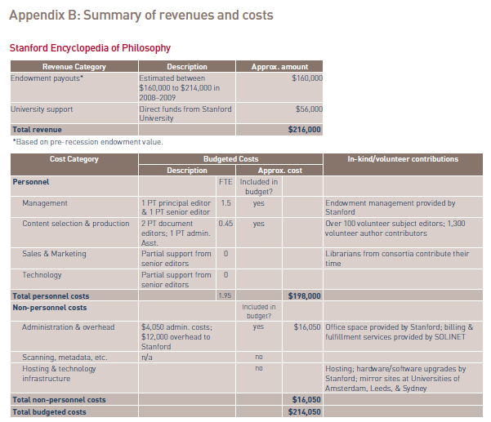
SEP’s post-grant project budget

Slide 36
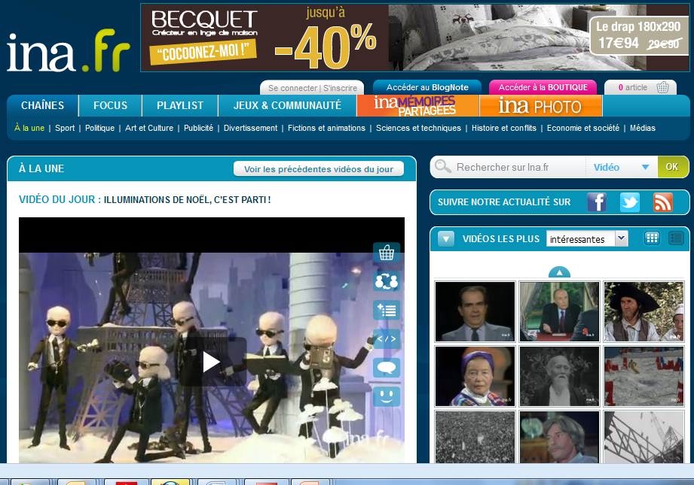
CASE STUDY: L’Institut National de l’Audiovisuel (INA)
Download fees for video content had leveled off, despite strong traffic on the site.
Usage data suggested obstacles were preventing users from purchasing downloads
They hypothesized that their audience would appreciate a DVD-on-demand service

Slide 37
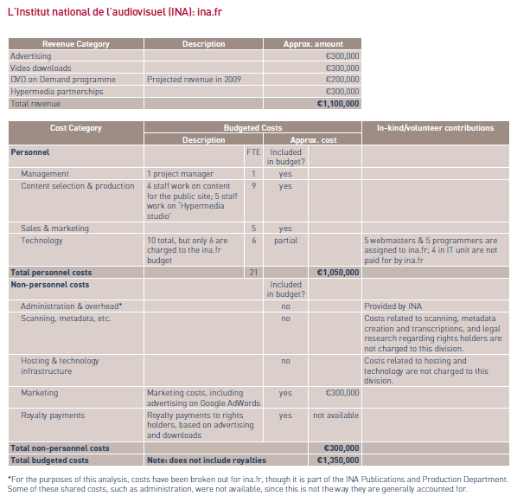
INA’s post-grant project budget

Slide 38
What have you tried?
What worked?
What didn’t work?
What do you think could work … and what do you need to know to proceed?

Slide 39
Where to Start: Prioritizing your choices

Slide 40
What has worked well? Where is your project facing challenges?
Audience
Funding Model
Organization
Product/service
Definition > Awareness > Usage
Definition > Implementation > Growth
Capabilities
Partnerships
Host support
Technology
Content
Preservation

Slide 41
Your Next Step: An action plan

Slide 42
Group Discussion
What are your key challenges going forward?
What is your best guess about how to overcome these challenges?
What would have to be true for this to work?
How can you test this? What do you need to know?

Slide 43
Thank you!
Rebecca Griffiths
Rebecca.griffiths@ithaka.org
Nancy Maron
nancy.maron@ithaka.org

